Slide 1
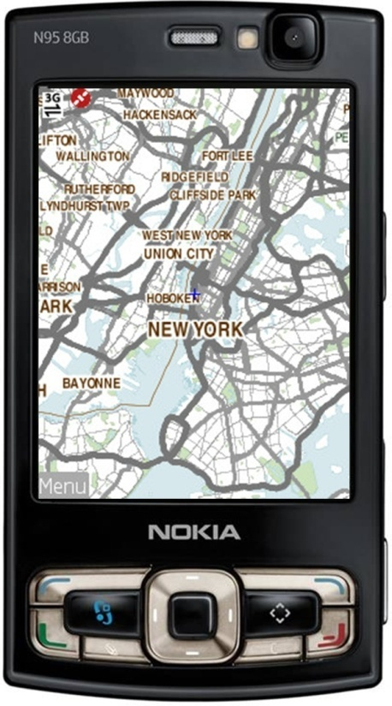
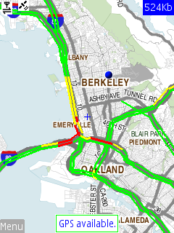
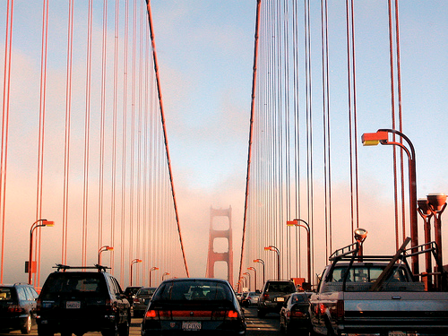

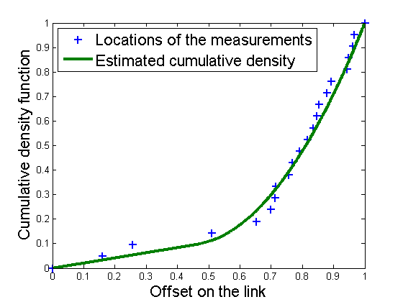

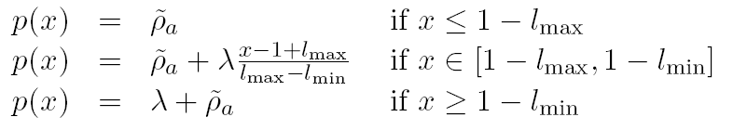







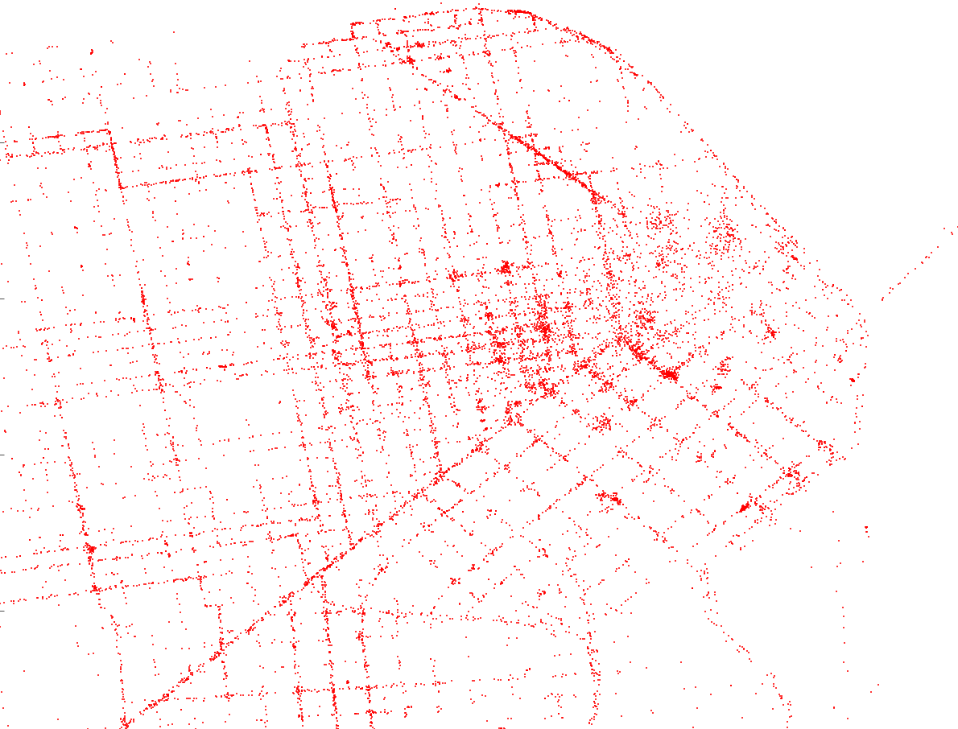
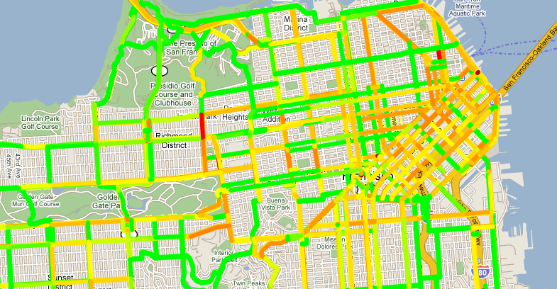
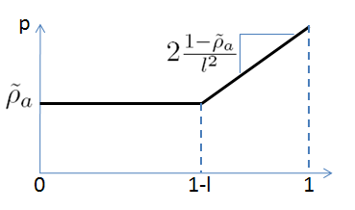
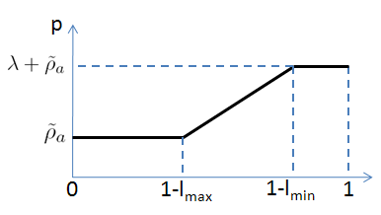
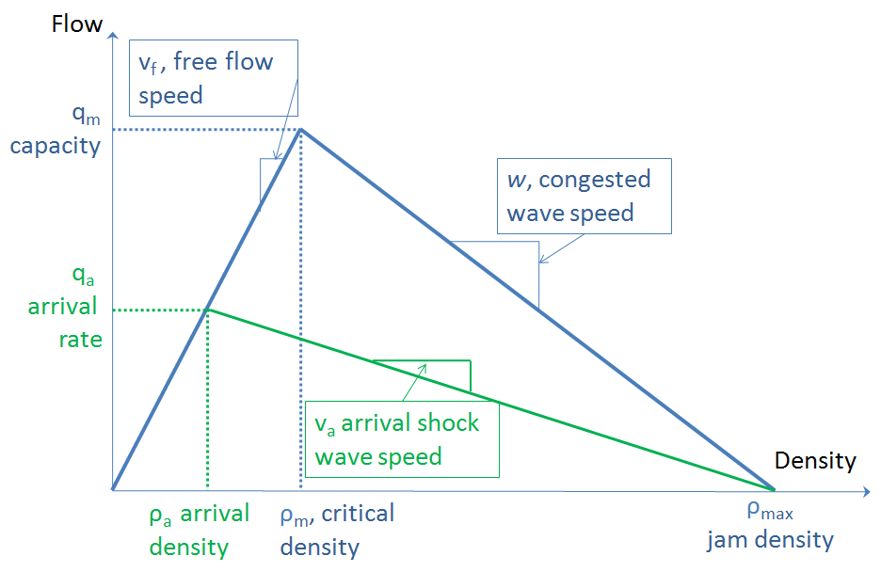


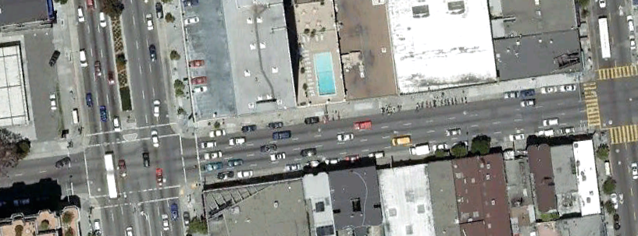
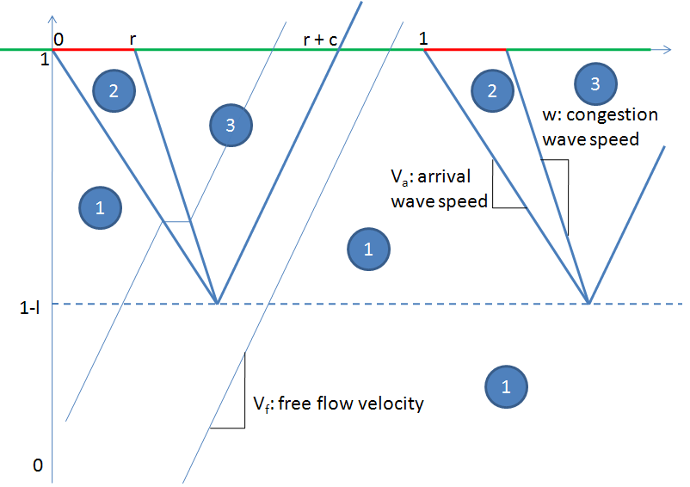

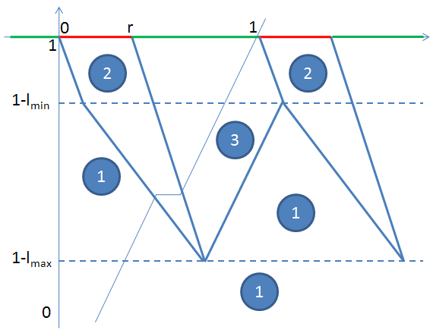
Traffic density estimation and travel time allocation on arterial roads
Aude Hofleitner
I Arterial Traffic Estimation
Data: Sparse GPS tracking on surface streets (arterial roads).
Goal: Travel time allocation on the links of the network
Scope of the project: estimation of the proportion of travel time between two points a and b on a link to allocate partial links travel time.
Use the probability distribution p of vehicle locations on a link.
III Parameterization of the pdf of vehicle locations
Undersaturated
Congested
V Results
Estimation of the parameters of the pdf (plot of the estimated and empirical cdf)
Because of the constraints on the parameters, the higher number of parameters in the congested model does not necessarily imply a better fit
=> Clustering algorithm: 70 labeled undersaturated (41%), 98 labeled congested
Average travel time between a and b
Average travel time of the link
or
ratio of the arrival density and the average number of cars
length of the queue
length of the queue of vehicles that have already stopped
Raw Data
Processed Output
Error metric on a new data set: Wasserstein metric. Average relative error: 11.28%
Undersaturated
Congested
II Arterial traffic modeling
Traffic flow model: triangular fundamental diagram. Queuing theory to estimate traffic statistics (queue, density…)
Two discrete traffic regimes:
undersaturated: the queue clears at each cycle,
congested: the queue does not clear
Traffic dynamics are represented by space time diagrams.
IV Experiment design and algorithm
GPS data from San Francisco taxi drivers. Send location and time. 50 taxis per day sending location every minute. Collected over 2 months.
Aggregate taxi location by Time Of the Day (TOD) and Day Of the Week (DOW). Time interval of aggregation: 1 hour
Results presented for Pine Street (downstream intersection with Van Ness)
Projected gradient ascent algorithm to maximize the log likelihood of the data with respect to the parameters of the pdf for both undersaturated and congested models (estimation)
Traffic regime estimation: choose the model with the best log likelihood score (clustering)
VI Conclusion and perspectives
Combination of a data driven and a traffic modeling approach to overcome the difficulties of calibration in traffic modeling without overfitting the data.
Define family of functions for the pdf of vehicle locations (one for undersaturated and one for congested) to estimate spatial travel time distribution on a link
Clustering algorithm to detect if a link is historically congested or undersaturated for a time of the day and day of the week.
Future directions:
Account for variations of the parameters around a mean value
Spatio-temporal evolution of the parameters
Integration in a traffic estimation graphical model that estimates and predicts travel time distributions using available real time data and historival estimates (Mobile Millennium project)
arrival density
maximum density
critical density
Van Ness Avenue
Pine
Street
Undersaturated
Congested

